Slide 1

Alan C. McMillan and Associates
OSHA ENFORCEMENT
AGENDA for NUCA CONFERENCE
JULY 21, 2023

Slide 2
1. History
2. OSHA Authority
3. Citations and Penalties
4. State Programs and Technical Assistance
5. Employer Rights
6. Employee Rights
7. Questions

Slide 4
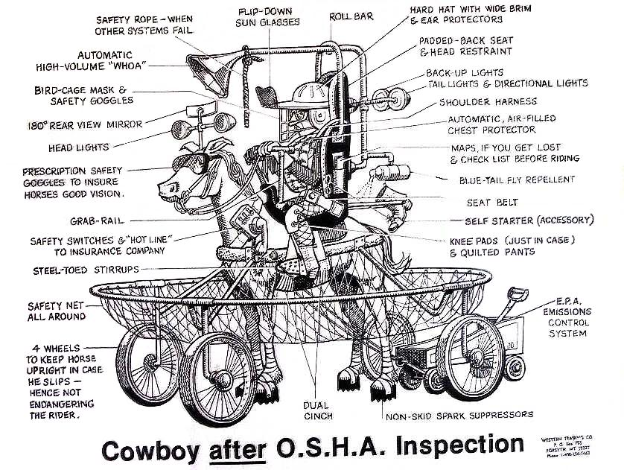

Slide 7
3) Citations and Penalties
1) Other than Serious (OTS)
2) Serious (Likely to cause serious physical harm or death)
3) Willful
4) Repeated
5) Failure to Abate
All are Civil Penalties

Slide 8
OSHA PENALTIES FOR 2023
Penalties levied by OSHA were increased by 7 percent due to a law that requires civil penalties to adjust for inflation
Penalties for serious violations are now up to $15,625.00
Penalties for willful or repeat violations are now up to $156,259.00

Slide 9
State Programs
1) Section 19(b) Enforcement and Standards; (“must be at least as effective as” )
2) Section 7(c)(1) State Consultation Programs. OSHA funds 90% for Consultation and Training in each state---most directed to small employers in high hazard industries.

Slide 10
Employer Rights
1) It is your company, not OSHA’s, and you can and should exercise the maximum control you have over the inspection process.
2) Opening Conference. OSHA must tell you why they are doing this inspection. This sets the scope of the inspection.
3) Always advise your headquarters ASAP.
4) OSHA will review the last 3 or 5 years of your 300, 300A and 301 records. You cannot deny these records.
5) OSHA will likely ask for an employee roster to select employees to interview. These interviews cannot be restricted and will be in private. Employees may refuse the interview but seldom do so.

Slide 11
6) Knowing your rights will assist you in keeping the inspection from being expanded and that should be your goal.
7) NEVER ALLOW THE CSHO TO BE UNACOMMPANIED
8) If OSHA takes a picture-You take the same picture.
9) If OSHA measures anything-You do the same.
10) The CSHO should never open equipment. They should always request the company to do so.
11) NEVER ALLOW ANY MANAGENT INDIVIDUAL BE INTERVIEWED ALONE. This covers anyone you consider a representative of management, including shift leaders, first line supervisors and project managers.
12) When any management representative is interviewed, they should NEVER SIGN THE WRITTEN STATEMENT THAT THE CSHO WILL ASK THEM TO REVIEW, CORRECT AND SIGN.

Slide 12
13) At the Closing Conference, the CSHO will ask for documents. Respond by requesting they put it in writing and that you will coordinate their request with corporate/headquarters advise them as soon as possible.
E) Employee Rights
1) To File Complaints
2) To Request Anonymity
3) If any retaliation, to file a discrimination complaint and receive Whistleblower status.

Slide 13
GENERAL ADVICE
Do not volunteer any information, answer questions directly without amplification and ALWAYS TELL THE TRUTH.
Always be polite and businesslike. Don’t misunderstand the CSHO is not your colleague. They are most likely to send you a citation you may not agree with.
Remember—your safety program is not motivated by fear or concern over an OSHA inspection, but by the culture of your organization and the program that you strive to achieve for both the company and its employees.

